Slide 1
Incentivizing Participation in Peer-to-Peer Ridesharing Platform
Fei Fang
Carnegie Mellon University
School of Computer Science
Institute for Software Research
feifang@cmu.edu
Joint work with Hoon Oh, Yanhan Tang, Zong Zhang, Prof. Alexandre Jacquillat
Thanks to Weilong Wang, Chun Kai Ling
Notes:
An Assistant Professor in ISR and an affiliated faculty at MLD.

Slide 2
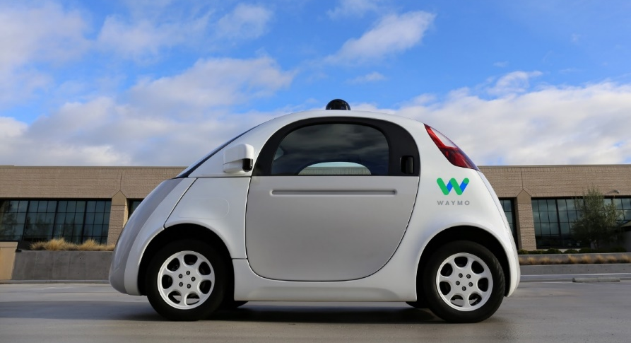
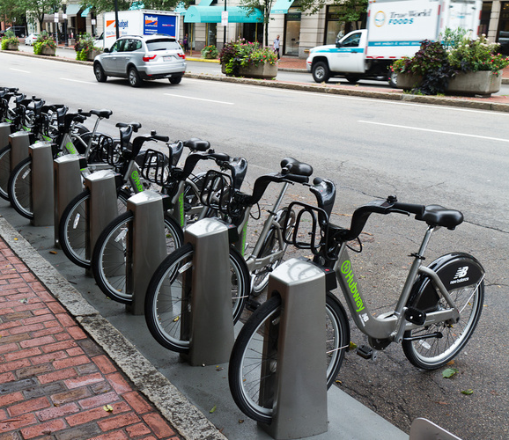
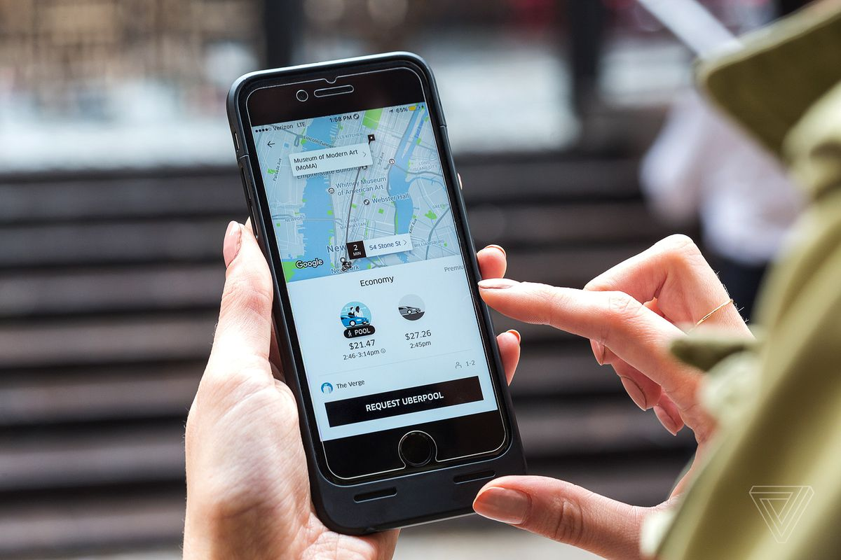
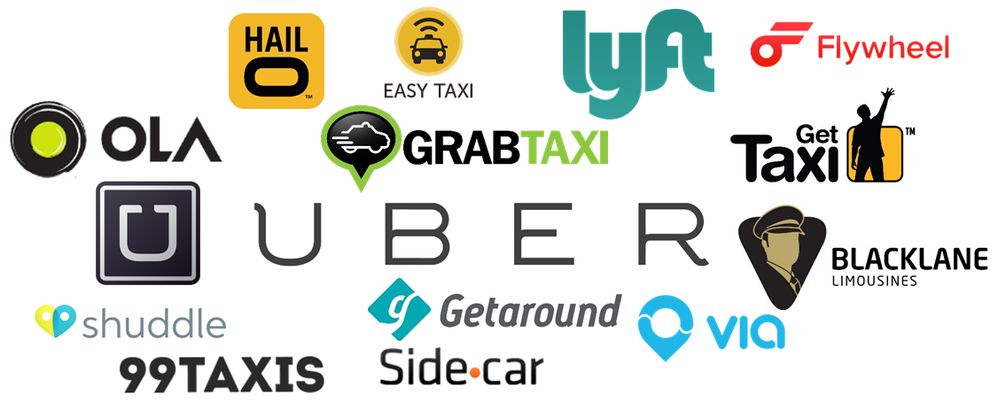
Revolution in Mobility

Slide 3
Mobility Challenge in Non-City Area
Mobility Challenge in Suburban / Rural Area
Lack of public transportation
Lack access to essential needs if no private vehicle
Commercial ridesharing platform cannot provide reliable service
Long waiting time
High cancellation rate
Expensive for daily commute
Notes:
Many residents in rural and suburban areas such as Lawrence County and several cities in Allegheny County rely extensively on private modes of transportation in daily commutes and other trips, and others without private vehicles lack access to their essential needs. Peer-to-peer ridesharing platforms that promote shared modes of transportation provides a promising opportunity to reduce the costs of travel and provide transportation alternatives.

Slide 4
Community-Based Peer-to-Peer Ridesharing
Community-Based Peer-to-Peer Ridesharing
Non-commercial platform
Identify carpooling opportunities
Community building
Existing platforms are not satisfactory
High overhead / Not flexible / Hard-to-use
No up-to-date information / No immediate response
No community-specific service
Do not leverage latest advances in technology
Privacy / Security concerns
Notes:
Such platforms connect commuters and enhance information sharing so that carpooling opportunities can be identified and leveraged. The key to the success of a peer-to-peer ridesharing platform is active participation of commuters. This research proposes to design incentive mechanisms to engage participants, to nurture and promote participation, and to improve the efficacy of the platform, with the ultimate objectives of creating a wide range of travel options that are consistent with participants’ preferences and system-wide objectives.

Slide 5
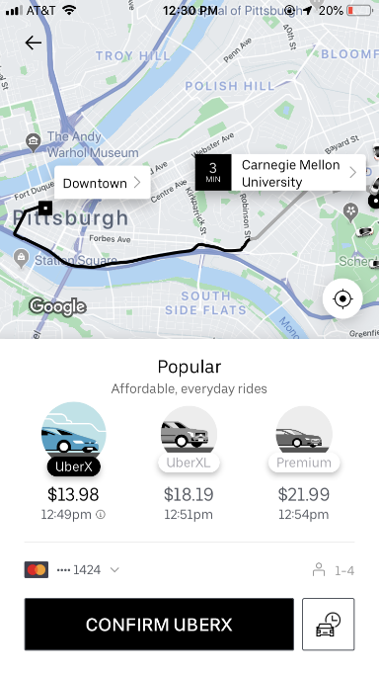
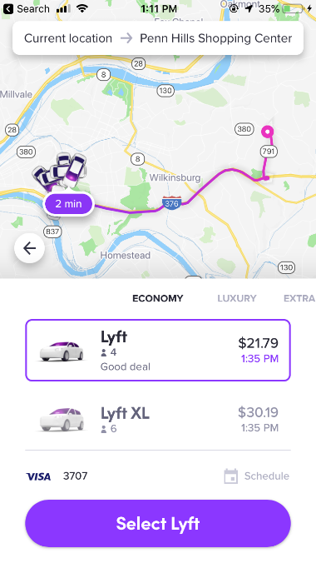
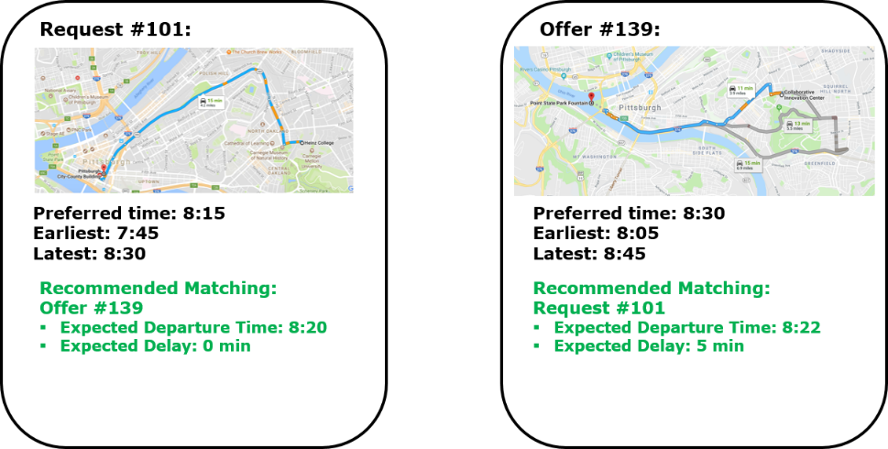
Community-Based Peer-to-Peer Ridesharing
Bring Smart City Technology to Suburban / Rural Area
Provide efficient matching in P2P Ridesharing
As easy-to-use as commercial ridesharing systems
User-Centric Aspects: Time preference, Fairness, Stability

Slide 6
Community-Based Peer-to-Peer Ridesharing
Research problem: Design algorithms for matching and beyond
Efficiently match riders and drivers given their constraints and preferences
Ensure fairness and stability of matching
Incentivize participation through rewarding scheme

Slide 7
Outline
Peer-to-Peer Ridesharing Platform
Matching Riders and Drivers to Maximize System Efficiency
Tradeoff between Efficiency, Fairness, and Stability
Incentivize Participation through Reward/Payment Scheme
Next Steps and Summary
Notes:
Learning informed game play

Slide 8
Model and Notations
$V$: Possible origin and destination locations
$\left[T\right]=\left\{1…T\right\}$: Discrete time horizon
$time(u,v)$: Travel time from $u$ to $v$ (following shortest or fastest path)

Slide 9
Model and Notations
$ℛ$: Set of riders
For each rider $r∈ℛ$
Origin $o_{r}$, Destination $q_{r}$, Time window $W_{r}=[τ_{r}^{e},τ_{r}^{l}]$
Preferred departure time $τ_{r}^{⋆}$, Maximum detour time $Δ_{r}$
Value of trip $v_{r}$
Cost to complete the trip if not matched to any driver $λ_{r}$
Coefficients in cost function
$\text{Cost} \text{if} \text{matched} \text{to} \text{a} \text{driver}\text{, }\text{picked} \text{up} \text{at} t \text{and} \text{dropped} \text{off} \text{at} t′$
$$C_{tt^{′}}^{r}=c_{det}^{r}\left(t^{′}−t\right)+c_{dev}^{r}|t−τ_{r}^{⋆}|$$
Linearly increasing w.r.t. detour time and deviation time
$𝒟$: Set of drivers
Each driver is characterized in a similar way

Slide 10
Optimization Problem for Efficient Matching
Simplest optimization objective: Minimize total cost
Let $c_{dS}$ denote the minimum total cost of driver $d$ and a subset of riders $S$ when $d$ is matched to $S$
Given a matching $π$, denote the set of riders picked up by driver $d$ as $S^{π}(d)$
$$\min_{π∈Π}{\sum_{d∈𝒟}{c_{dS^{π}(d)}}+\sum_{r∈ℛ:r∉∪_{d^{′}∈𝒟}S^{π}(d^{′})}{λ_{r}} }$$

Slide 11
Two-Stage Algorithm to Minimize Total Cost
Two-Stage Algorithm
Stage 1: Compute $c_{dS}$ for all feasible $d−S$ pairs
Use the RTV-graph (Rider-Trip-Vehicle) framework [Alonso-Mora et al, 2017] to enumerate feasible $d−S$ pairs and compute $c_{dS}$ incrementally
$d−S$ is feasible only if $d−S′$ is feasible, $∀S^{′}⊂S$ and $\left|S^{′}\right|=\left|S\right|−1$
For each $d−S$, find optimal schedule through tree search with Mixed Integer Linear Programming (MILP) for leave nodes
Dynamic Programming based heuristic solution; Further pruning by learning from similar $d−S$ pairs;
Stage 2: Find the best matching
Given the computed $c_{dS}$ for all the feasible $d−S$ pairs, match each driver with one subset of riders. Solved through standard MILP

Slide 12
Is Cost Minimization Enough?
Limitation
Does not explicit reason about cost-benefit analysis of individual participants
No consideration for fairness and stability
Agent Utility Model
Rider utility
$U_{r}=v_{r}−C_{tt^{′}}^{r}$ if matched
$U_{r}=v_{r}−λ_{r}$ if not matched
Driver utility
$U_{d}=v_{d}−C_{tt^{′}}^{d}$
Altruistic factor $ρ_{d}$
Altruistic utility (perceived utility) ${\tilde{U}}_{d}=U_{d}+ρ_{d}\sum_{r∈S(d)}{U_{r}}$

Slide 13
Fairness
If follow cost minimization, rider who is slightly “dominated” will never get a ride
Consider probabilistic matching instead
For frequent or repeated ride requests, to be fair, the slightly dominated rider deserve some probability of getting matched (rematching every season)
Fairness: Ensure that each participant $i$ is matched with a minimum probability $θ_{i}$ as long as there is a feasible matching. Assume $θ_{i}=θ,∀i$.
A
B
CMU
C

Slide 14
Stability
Individual level (Individual Rationality)
$U_{r}≥v_{r}−λ_{r}$, ${\tilde{U}}_{d}≥v_{d}−c_{det}^{d}⋅time\left(o_{d},q_{d}\right)$
No worse than not getting matched and just going by oneself
Otherwise no incentive to participate in matching
Group level (Ex-Post Stability)
A matching $M$ is stable if there is no blocking pair $\left(d,S\right)$
$\left(d,S\right)$ is a blocking pair if $d−S$ is not matched in the current matching but the driver and all the riders can get higher utility when they are matched together

Slide 15
External Reward to Improve Stability
External reward (e.g., coupons provided by community partners) can be used to ensure stability
$B$-Stable Matching
A matching $M$ is $B$-stable if there exists a way to distribute the external reward $B$ to individual participants, represented by vector $β$, such that there is no blocking pair $\left(d,S\right)$ given the distributed external reward $β_{i}$ ($\sum_{i}{β_{i}}≤B$)

Slide 16
Experiments
Simulated instances reflecting daily commute in a neighborhood. $k_{d}=4$

Slide 17
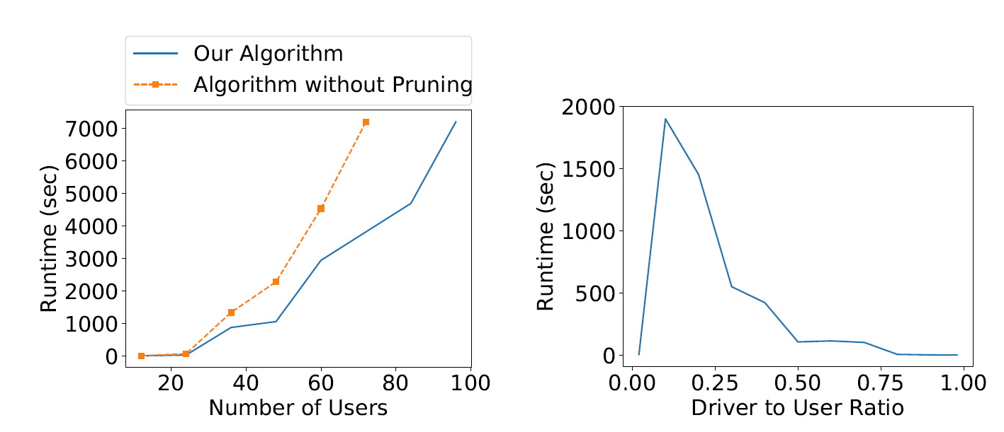
Scalability
Our novel pruning reduce runtime significantly
More time needed when driver-to-rider ratio is around 0.2 (as expected since $k_{d}=4$)

Slide 18
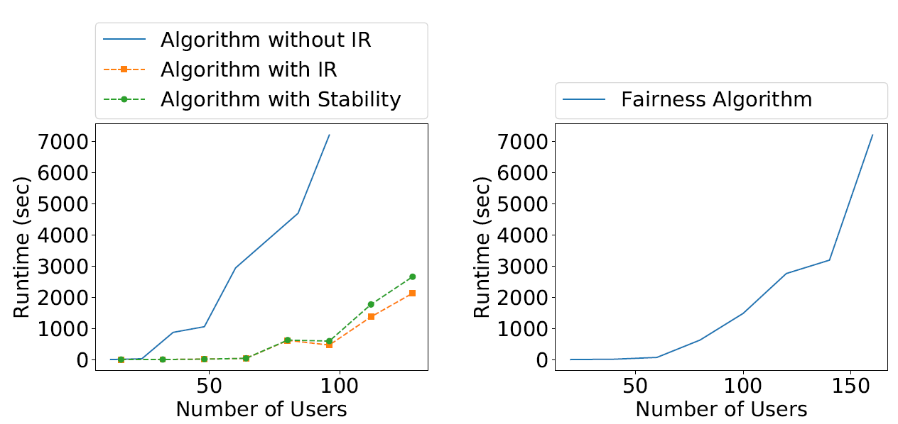
Scalability with Fairness and Stability Constraints
IR constraints serve as “cuts” and reduce the runtime

Slide 19
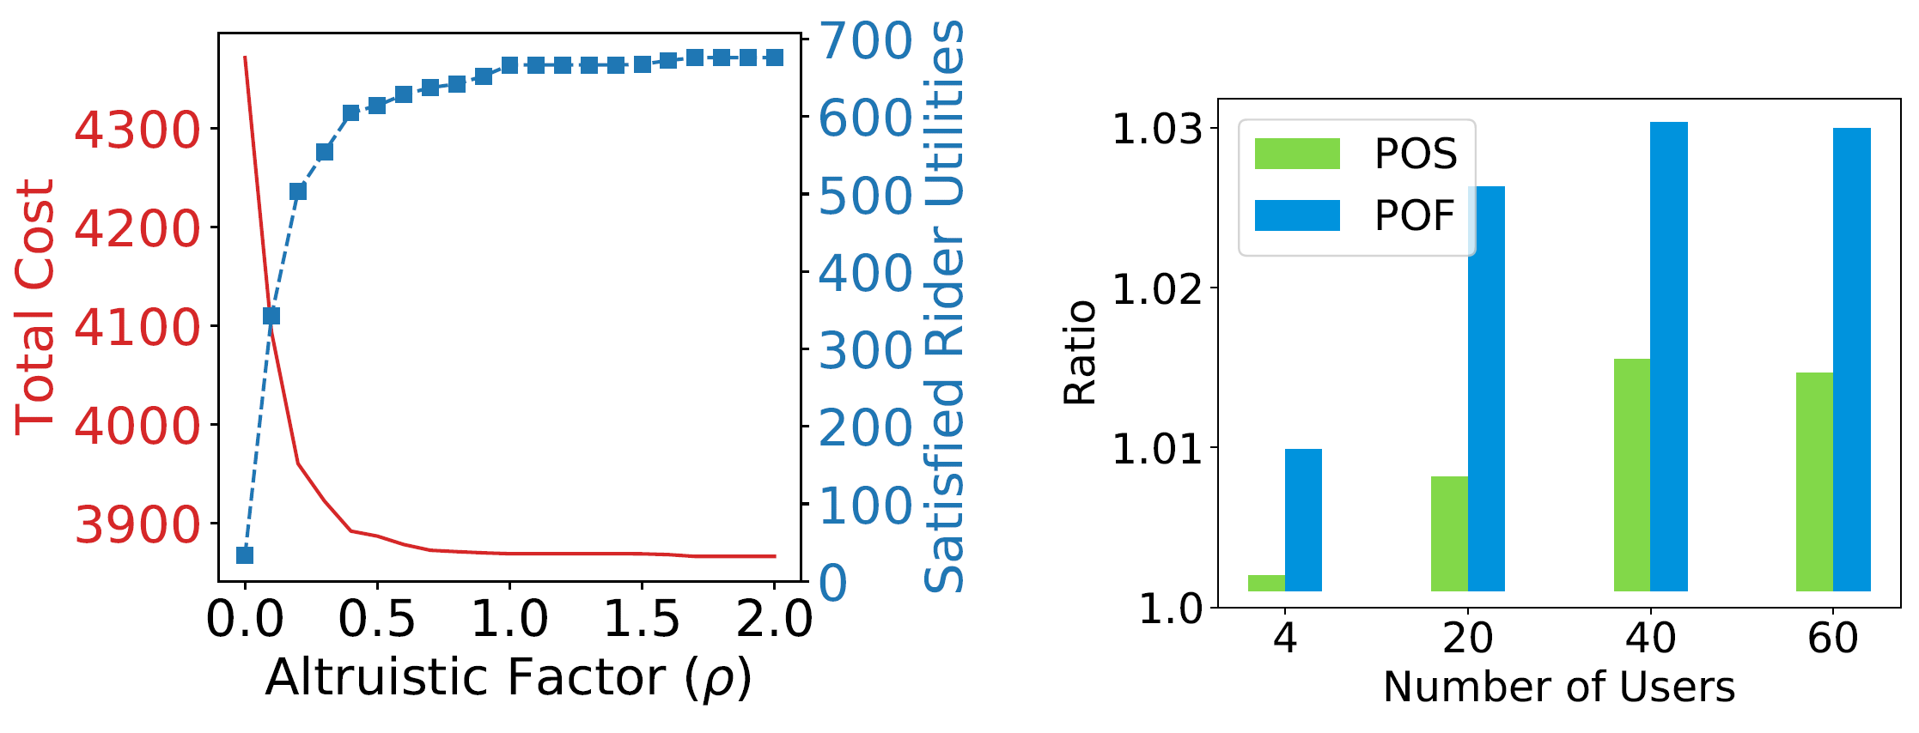
Tradeoff between Efficiency, Fairness and Stability
Price of Stability (POS) and Price of Fairness (POF) is low in experiments

Slide 20
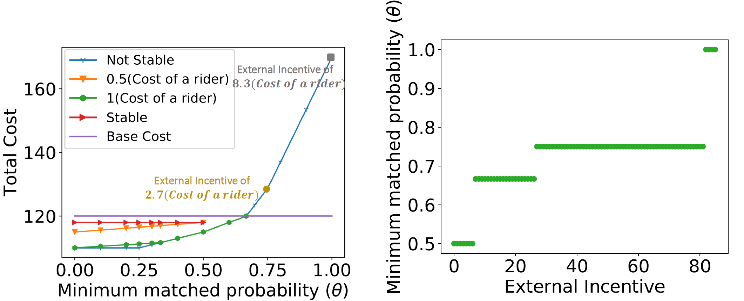
Tradeoff between Efficiency, Fairness and Stability
Pareto frontier of
Efficiency vs fairness (with stability as constraint)
Fairness vs external incentive

Slide 21
Next Step: Other Reward / Payment Scheme
Further incentivize participation
Approach 1: Scoring system to determine $θ_{i}$ - minimum probability of getting matched
Approach 2: Suggest payment from rider to driver

Slide 22
Next Step: Evaluation with Real World Data
In collaboration with
Lawrence County
Allegheny County Department of Human Service Office of Community Services
Hulton Arbors
Survey results from residents in Hulton Arbors expected in April/May

Slide 23
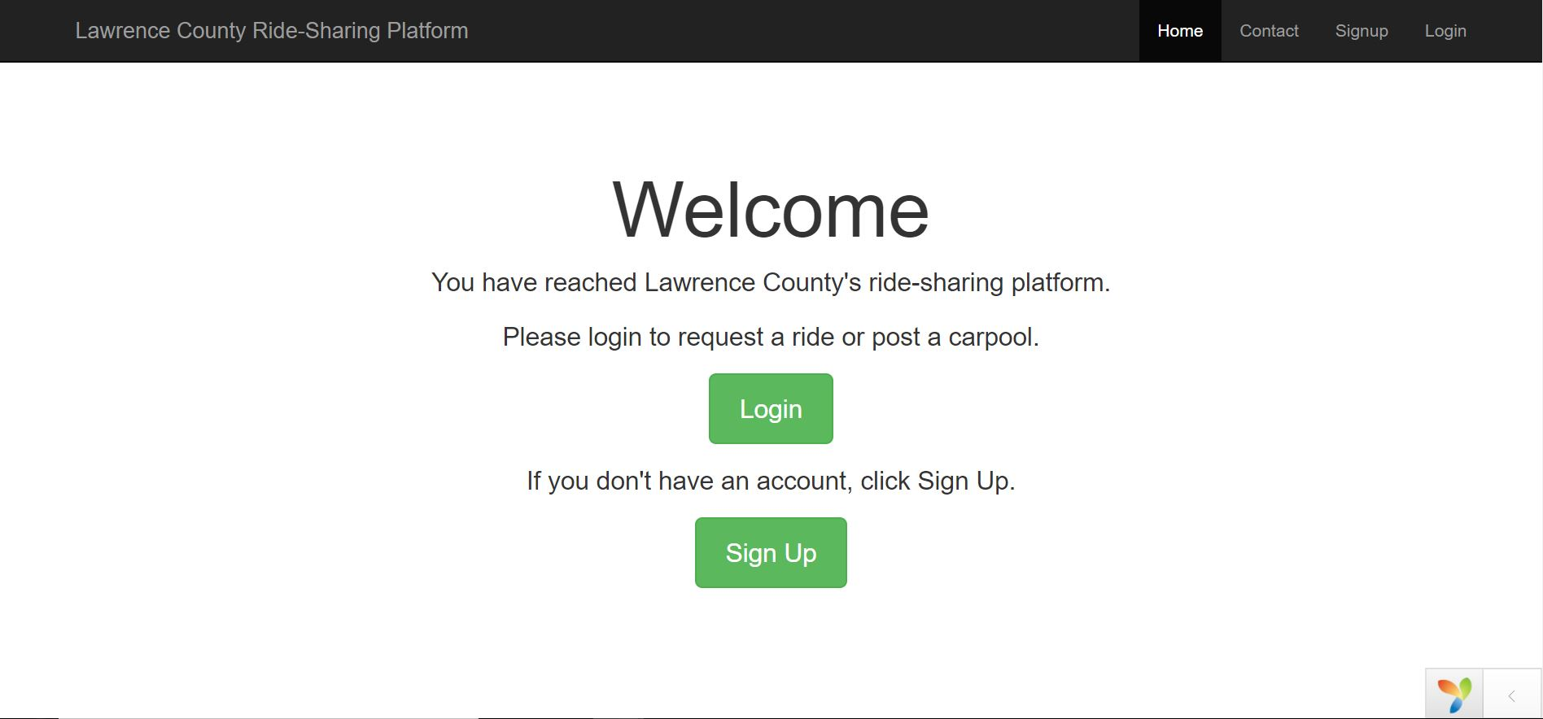
Future Work: Integration
Integrate the algorithm into an online platform

Slide 24
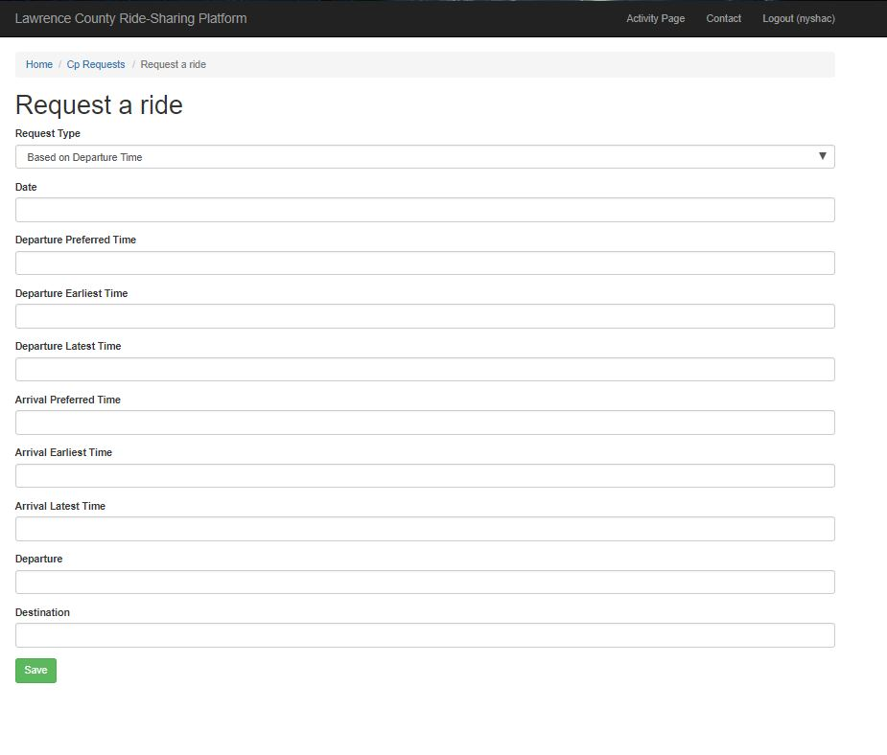
Future Work: Integration
Request a Ride Page

Slide 25
Summary
Peer-to-Peer Ridesharing Platform
Need to consider the utility model of the participants
Tradeoff between Efficiency, Fairness, and Stability
Incentivize participation through reward/payment scheme
Fei Fang
Carnegie Mellon University
feifang@cmu.edu
Notes:
AI research that can deliver societal benefits now and in the near future

