Slide 1
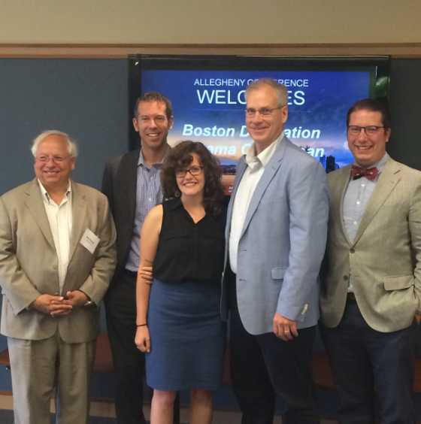
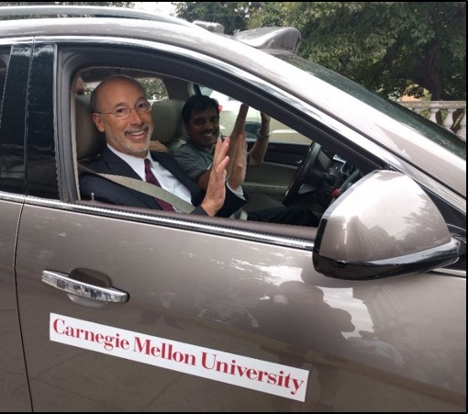
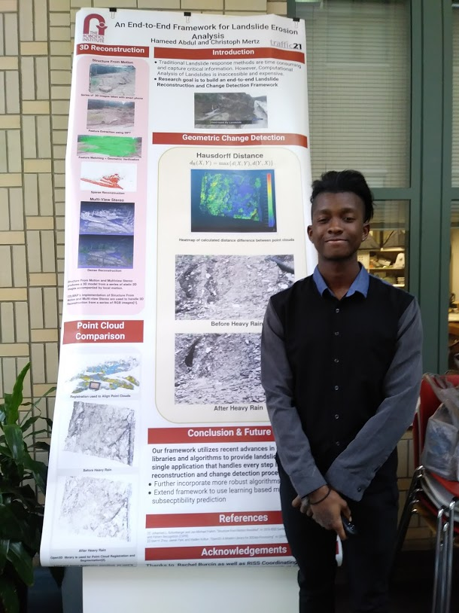
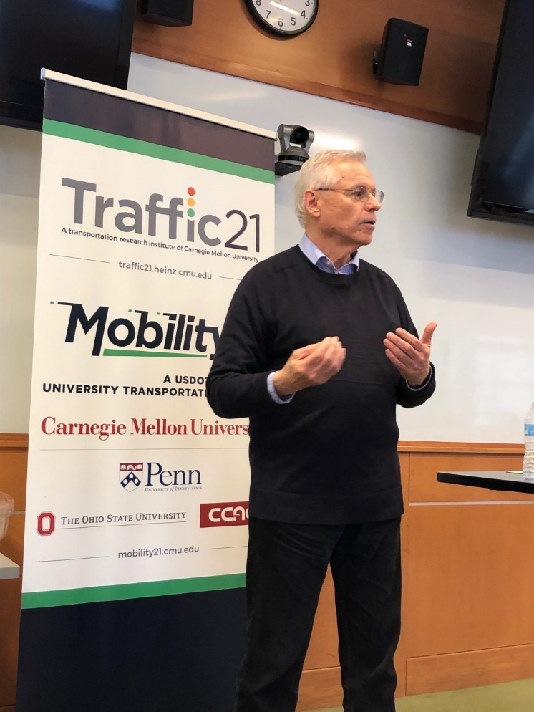
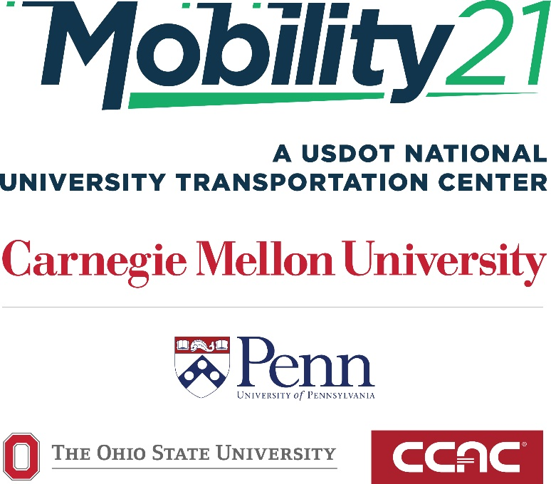
Stan Caldwell, Executive Director
Notes:
Traffic21 is a University wide initiative.
The purpose today is not so much to report on research results;
but rather to report on a research program.
One which may provide you with an opportunity

Slide 2
AI Executive Education Motivation
Public and Private Transportation Organizations are Impacted by AI Today
Hype of AI Creating Misconceptions
Gap in AI Education Opportunities for Current Transportation Managers
Organizations Need Strategic Approach Managing AI

Slide 3
Students who complete this program will be able to:
• Describe the current landscape of AI and other disruptive technology in the transportation sector
• Understand the risks/benefits of AI utilization to stakeholders
• Determine the best way to introduce and manage AI within a transportation organization
• Understand the components of an enterprise AI strategy and the tactics for building AI capabilities in an organization

Slide 4
DETAILED AGENDA
Session 1: Overview of Technology and AI Impacts in Transportation Today
Session 2: AI in Traffic Control Devices
Session 3: AI in Connected/Autonomous Vehicles
Session 4: AI and Predictive Analytics: How to Make Better Decisions with Transportation Data
Session 5: AI in Transportation Asset Management
Session 6: Equitably Applying AI for Safe and Efficient Transportation
Session 7: Developing and Implementing an Enterprise AI Strategy

